Slide 1
E-LEARNING WEB APPLICATION PLATFORM
ASWENI N
3RD YEAR CSE DEPT
VELAMMAL INSTITUTE OF TECHNOLOGY

Slide 2
OBJECTIVE
E-learning fulfils the thirst of knowledge and offers online content that can be delivered for the learner at anywhere, anytime and any age through a wide range of e-learning solution while compared with traditional learning system.
. The application has online video lectures, sample papers of various competitive exams, daily brain teasing questions to improve IQ, performance and ranking report, discussion with tutors and mentors, 24x7 online support, free online computer courses, feedback, etc…

Slide 3
EXISTING SYSTEM
In the existing system the exams are done only manually but in proposed system we have to computerize the exams using this application.
Lack of security of data.
More man power.
Time consuming.
Needs manual calculations.
No direct role for higher officials.

Slide 4
PROPOSED SYSTEM
The aim of proposed system is to develop a system of improved facilities. The proposed system can overcome all the limitations of the existing system. The system provides proper security and reduces the manual work.
Proper control of the higher officials.
Minimum time required.
Greater efficiency.
Security of data.

Slide 5
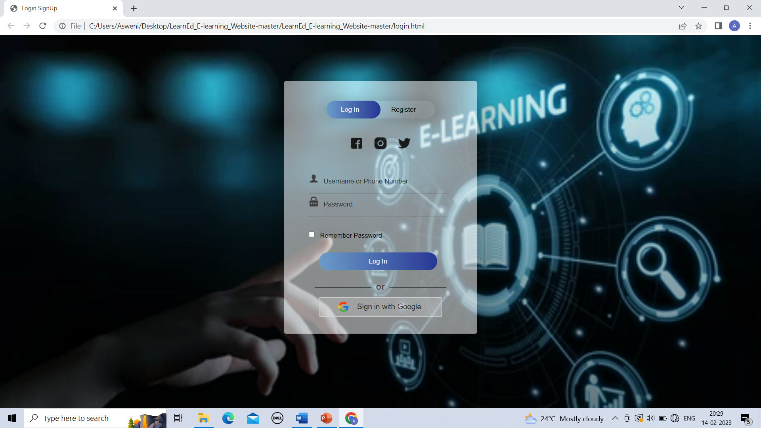
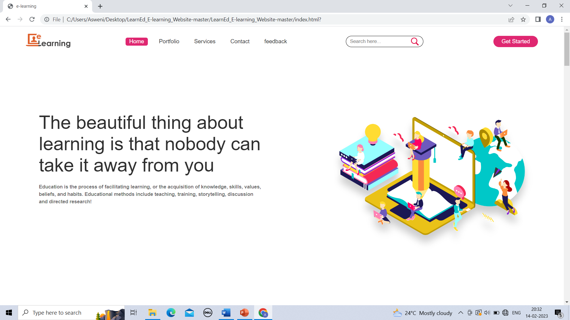
IMAGES OF WEBSITE
Login Page
Home Page

Slide 6
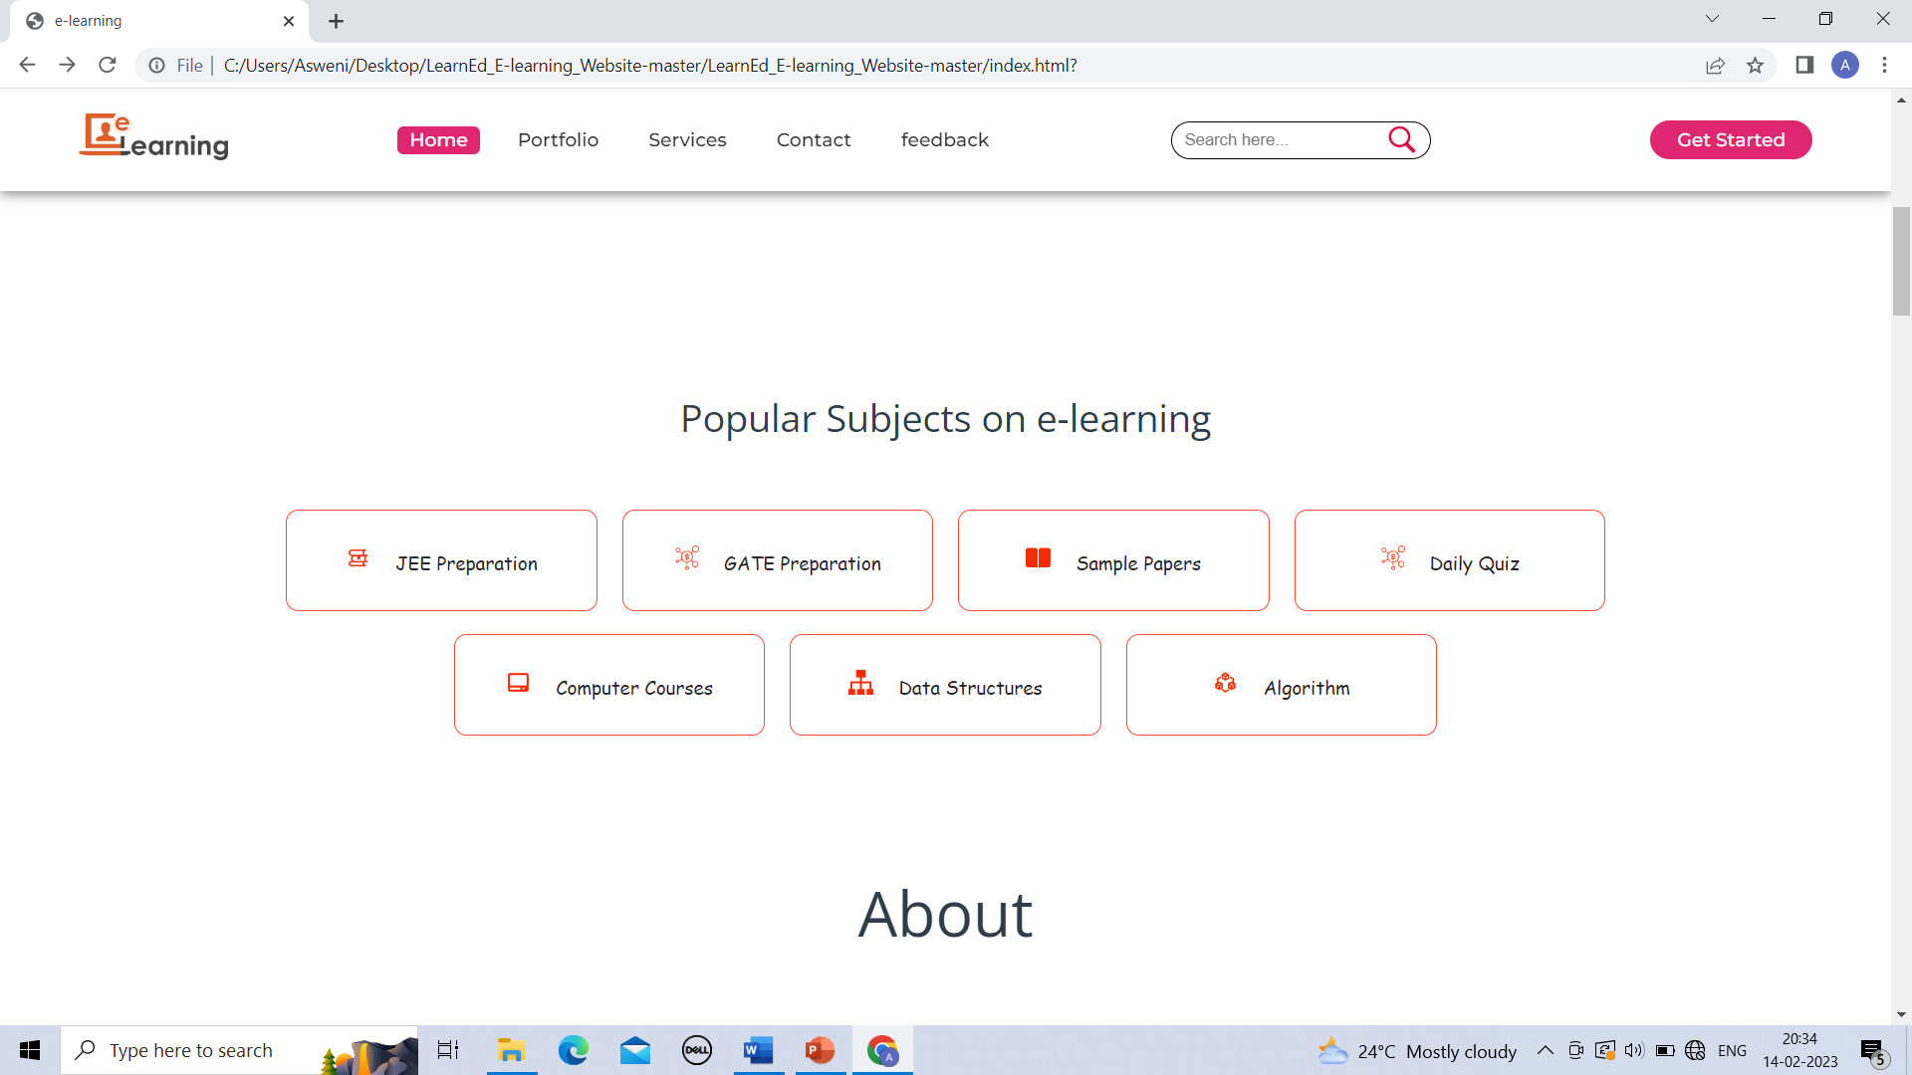
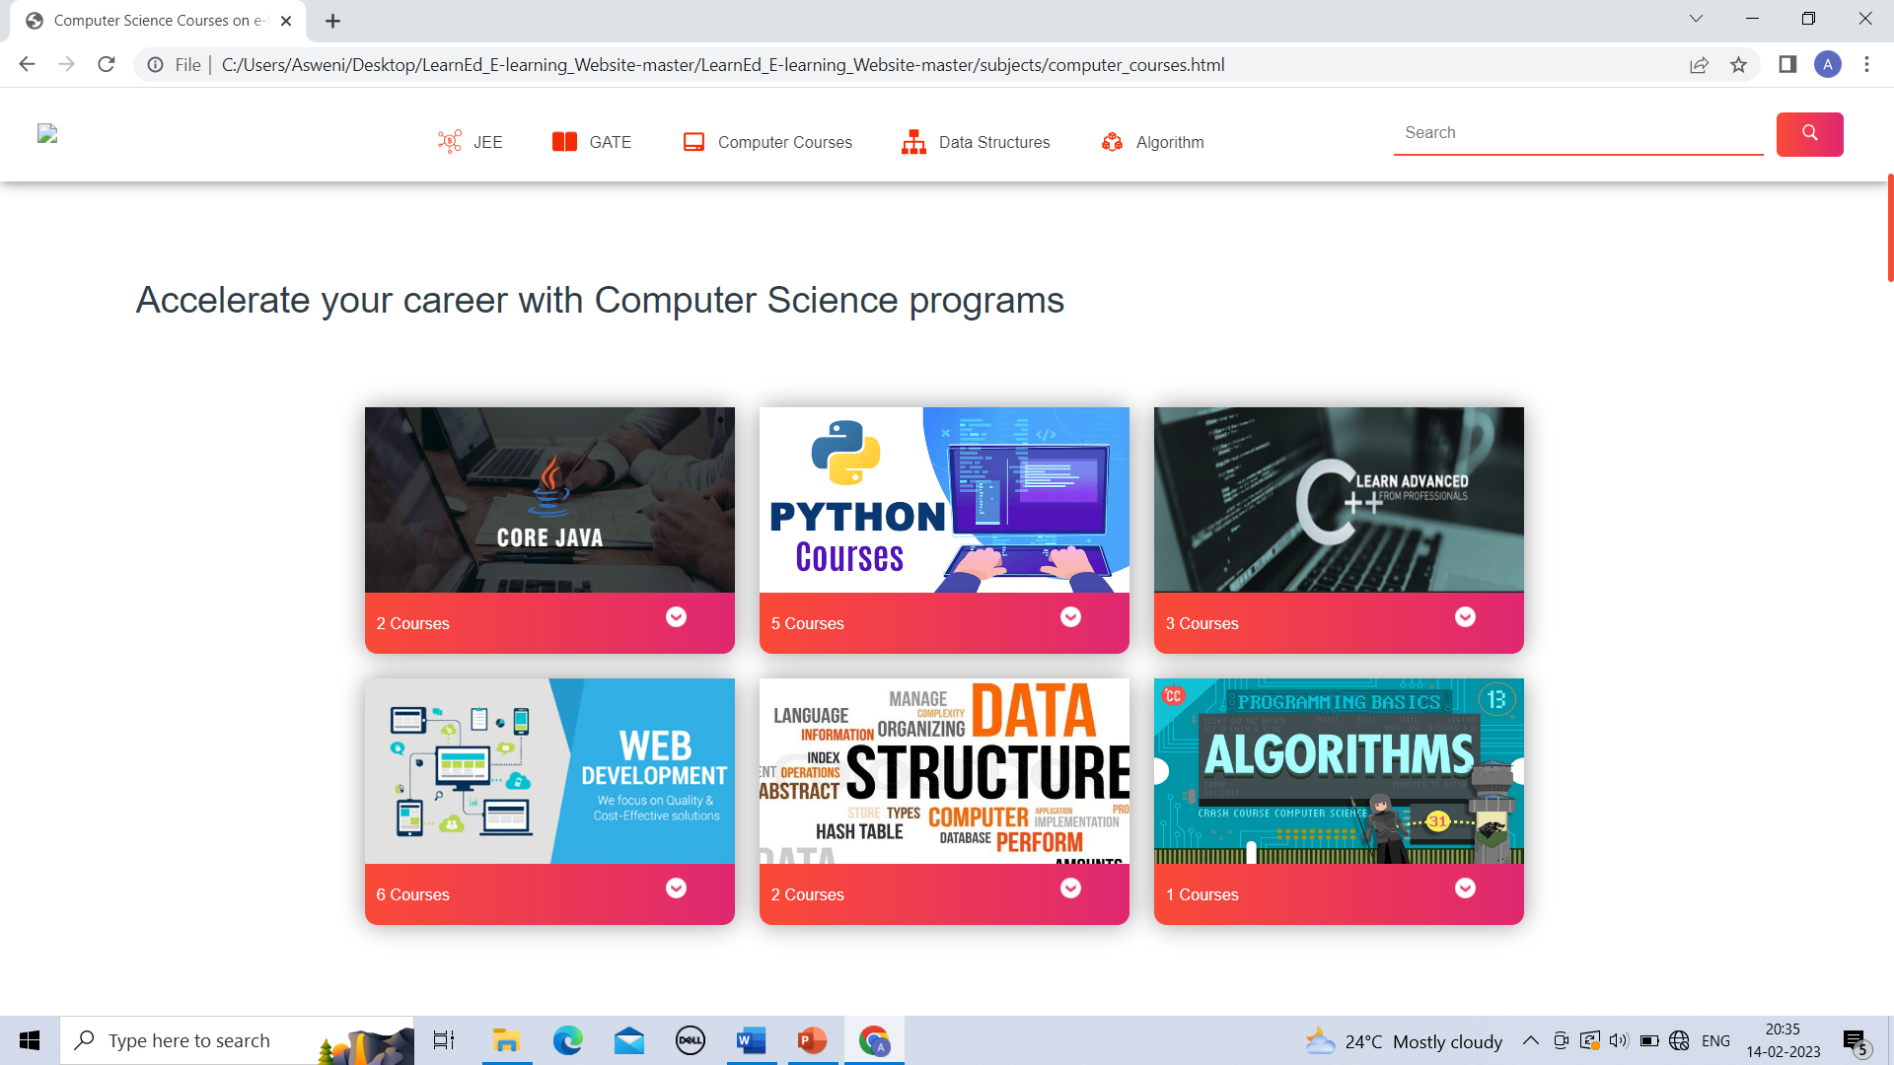
IMAGES OF WEBSITE
Subjects
Courses

Slide 7
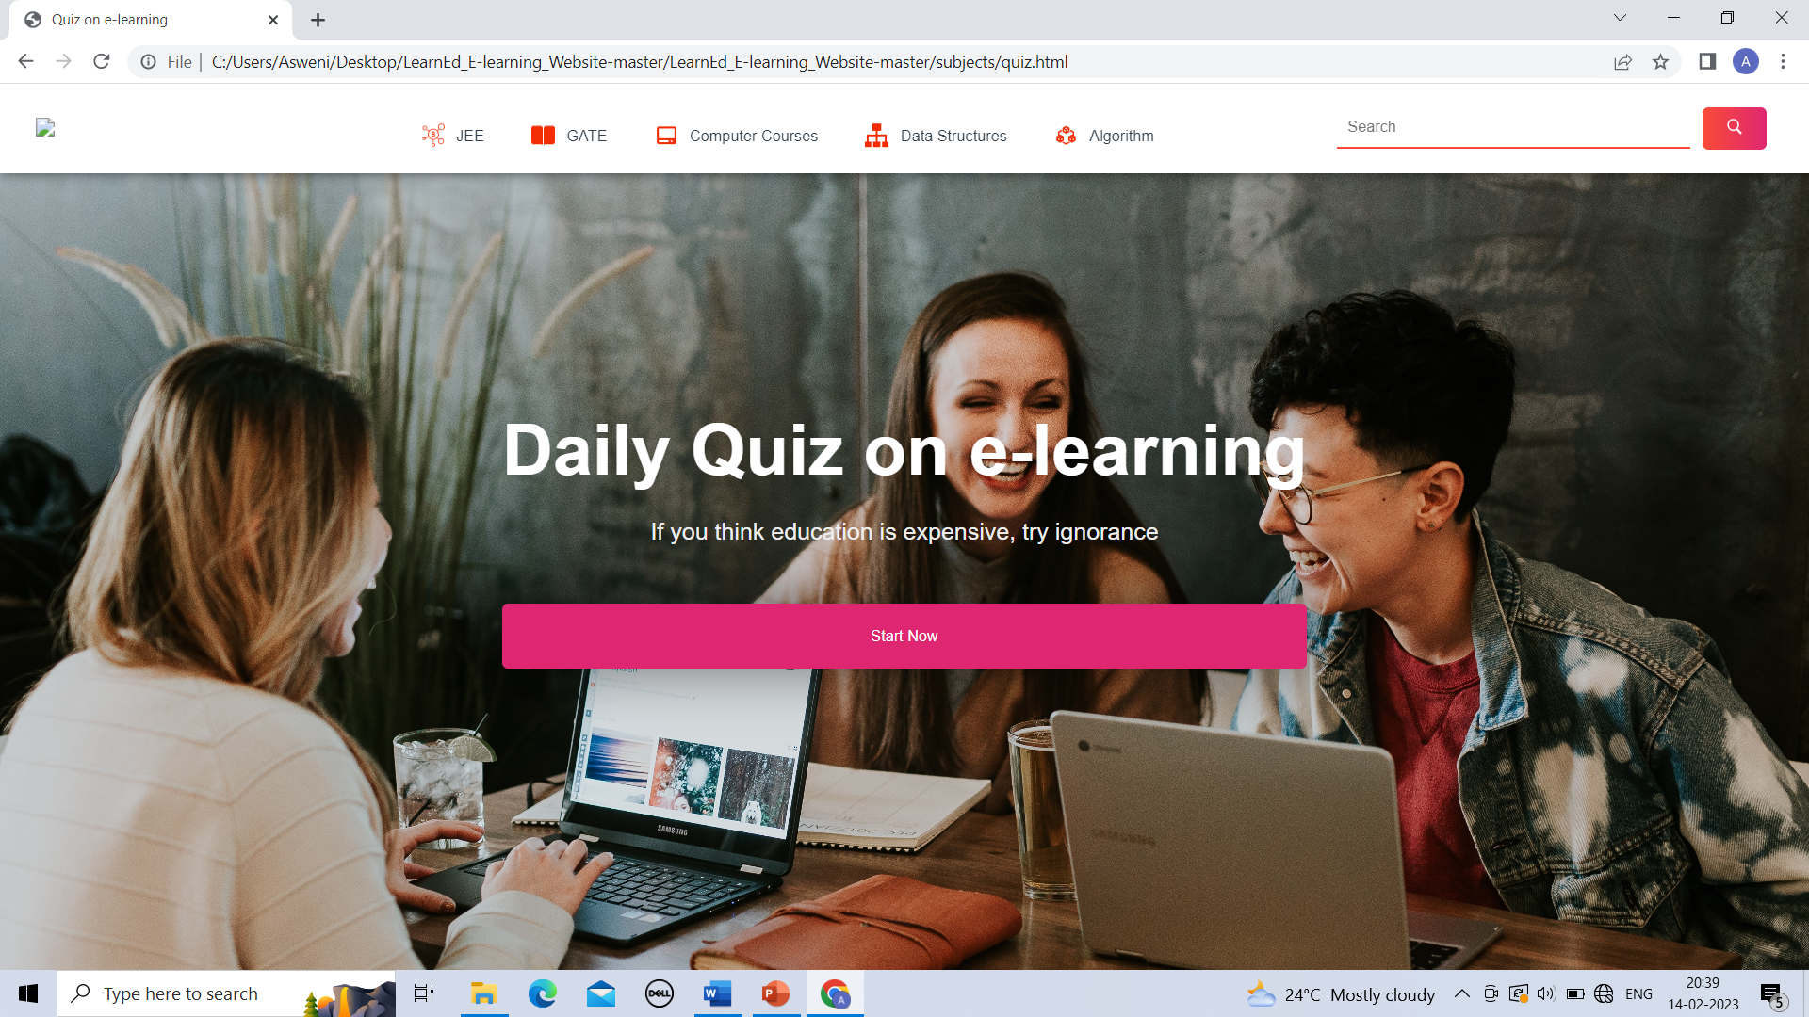
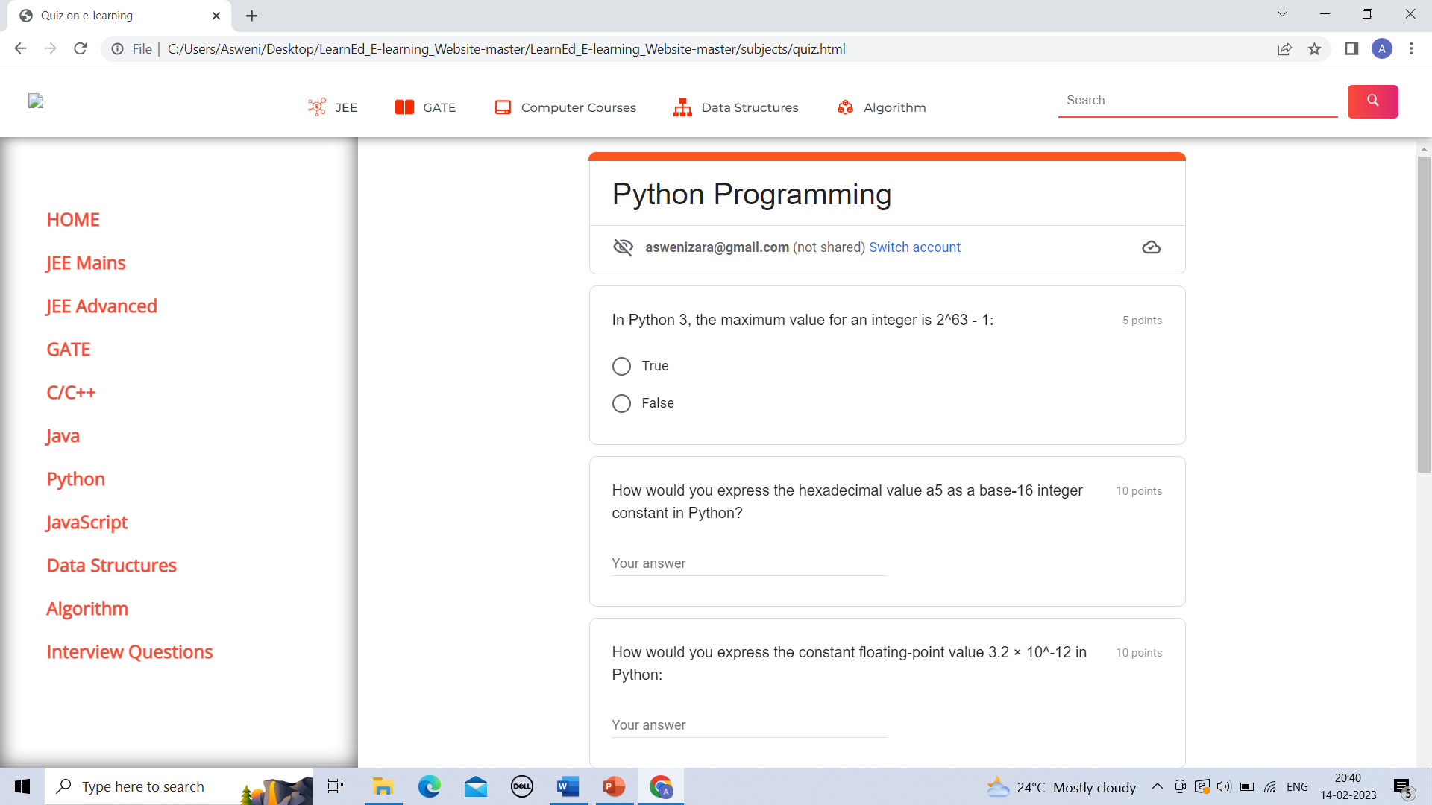
IMAGES OF WEBSITE
Daily Quiz
Quiz page

Slide 8
CONCLUSION
E-learning is not just a change of technology. It is concluded that the description of the background and context of the project and its relation to work already done in the area. We understand the problem domain and produce a model of the system, which describes the operations that can be performed on the system.

